Slide 1
Assignment - 6
Operating Systems

Slide 2
Question 2
Two processes can communicate using shared memory. Similarly they can communicate using a
‘socket’.
Socket based inter-process communication is more powerful than shared memory based
communication as it gives you the power to enable communication between two processes
running even on two different physical computers (connected by a LAN/WLAN). Study the pages
p. No. 48 - p. No. 51 of Unix System Programming Part-II (“Prog-II.pdf”) document to learn
socket programming.
Now, implement a client-server project where the client and server should communicate
using sockets. Server should provide a computing service which a client / clients can request.
Service: Calculate the LCM of 4 given integers

Slide 3
Group - 6
Abhijeet Sonkar
Aditya Aggarwal
IIB2019009
IIT2019210
Ambika Singh
Avneesh Kumar
Divy Agarwal
IIB2019017
IIB2019010
IIT2019211

Slide 4
Table of content
01
Basic Concepts
02
Code and Explanations
03
Output Screenshots

Slide 5
1. Basic Concepts

Slide 6

Socket Programming
Socket programming is a way of connecting two nodes on a network to communicate with each other. One socket(node) listens on a particular port at an IP, while other socket reaches out to the other to form a connection. Server forms the listener socket while client reaches out to the server.
Client Process
This is the process, which typically makes a request for information. After getting the response, this process may terminate or may do some other processing.
Socket
Programming
Server Process
This is the process which takes a request from the clients. After getting a request from the client, this process will perform the required processing, gather the requested information, and send it to the requestor client. Once done, it becomes ready to serve another client. Server processes are always alert and ready to serve incoming requests.

Slide 7
2. Code & Explanation

Slide 8
Server.c
int gcd(int a, int b){
if (b == 0)
return a;
return gcd(b, a % b);
}
int lcm(int arg[]){
int lcm=arg[0];
for(int i=1;i<4;i++){
lcm=((arg[i]*lcm)/gcd(arg[i],lcm));
}
}
This function takes 2 integers and return their gcd.
This function takes an array as input and returns the lcm of fixed number of integers present in the array
This if condition will ensure that port number is provided or not. If port is not provided then server process can't be started rather it will display the error and exits.
int main(int argc,char * argv[]){
if(argc<2){
fprintf(stderr, "Please provide the port number");
exit(1);
}
int sockfd, newsockfd, portno, n, ans=1;
char buffer[1024];
pid_t childpid;
struct sockaddr_in server_address,client_address;
socklen_t client_len;
These are the variable declarations used in the server process.
Structure describing an Internet socket address.
Created a unsigned int of socklen_t type

Slide 9
Create a new socket of TYPE in DOMAIN( here is AF_INET), using PROTOCOL. If PROTOCOL is zero, one is chosen automatically(protocol is 0 so that it can choose by itself). Returns a file descriptor for the new socket, or -1 for errors.
Sets N( here is sizeof(server_address) ) bytes of S( here is server address ) to 0.
Port number that is stored at first index of argv is converted into integer by atoi and then stored in portno
sockfd=socket(AF_INET,SOCK_STREAM,0);
if(sockfd<0){
perror("Error in creating a socket");
exit(1);
}
bzero((char *) &server_address,sizeof(server_address));
portno=atoi(argv[1]);
server_address.sin_family=AF_INET;
server_address.sin_addr.s_addr=INADDR_ANY;
server_address.sin_port=htons(portno);
int tr=1;
if(setsockopt(sockfd,SOL_SOCKET,SO_REUSEADDR,&tr,sizeof(int))==-1){
perror("Not a useable port");
exit(1);
}
if(bind(sockfd,(struct sockaddr *) &server_address,sizeof(server_address))<0){
perror("Not able to bind");
exit(1);
}
The elements in the structure are assigned their values.
This helps in manipulating options for the socket referred by the file descriptor sockfd. This is completely optional, but it helps in reuse of address and port. Prevents error such as: “address already in use”.
After creation of the socket, bind function binds the socket to the address and port number specified in addr(custom data structure).

Slide 10
listen(sockfd,5) Prepares to accept connections on socket FD. 5 connection requests will be queued before further requests are refused.
listen(sockfd,5);
client_len=sizeof(client_address);
while(1){
newsockfd = accept(sockfd, (struct sockaddr*)&client_address, &client_len);
if(newsockfd < 0){
exit(1);
}
printf("Connection accepted from %s:%d\n", inet_ntoa(client_address.sin_addr), ntohs(client_address.sin_port));
Awaits for a connection on socket FD.
When a connection arrives, open a new socket to communicate with it, set *ADDR (which is client_len bytes long) to the address of the connecting peer and *ADDR_LEN to the address's actual length.
Returns the new socket's descriptor, or -1 for errors, on error will print it and exits

Slide 11
if((childpid = fork()) == 0){
close(sockfd);
bzero(buffer,1024);
printf("\tNow taking input from client\n");
int arg[4];
n=read(newsockfd,arg,sizeof(arg));
if(n<0){
perror("Error while reading");
exit(1);
}
ans=lcm(arg);
n=write(newsockfd,&ans,sizeof(int));
if(n<0){
perror("Error while writing");
exit(1);
}
}
}
close(sockfd);
close(newsockfd);
fork: It creates a child process and this block will run for child only.
close: child sockfd is closed.
bzero: Sets 1024 bytes of buffer to 0.
read: Reads N BYTES into BUF(arg) from FD(newsockfd). Return the number read, -1 for errors or 0 for EOF.
lcm: calculates and stores the result.
write: Writes 4 bytes of ans to newsockfd. Return the number written, or -1.
At the end close both the FD.

Slide 12
client.c
Structures describing an Internet socket address.
These are the variable declarations used in the client process.
int sockfd,portno,n;
struct sockaddr_in server_address;
struct hostent *server;
char buffer[255];
if(argc<3){
fprintf(stderr,"usage %s hostname port\n",argv[0]);
exit(1);
}
portno=atoi(argv[2]);
sockfd=socket(AF_INET,SOCK_STREAM,0);
if(sockfd<0){
perror("Error in creating a socket");
exit(1);
}
server=gethostbyname(argv[1]);
if(server==NULL){
fprintf(stderr,"Error, no such host");
exit(1);
}
bzero((char *) &server_address,sizeof(server_address));
server_address.sin_family=AF_INET;
Port number that is stored at second index of argv is converted into integer by atoi and then stored in portno.
Creates a socket as in server and also checks for errors
Return entry from host data base for host with NAME(argv[1]).
bzero Sets the given amount bytes of server address to 0 as in server process.
Structure has been assigned the value of sin_family as AF_INET.

Slide 13
Copy the given bytes of server->h_addr_list[0] to server_address.sin_addr.s_addr.
bcopy((char *) server->h_addr_list[0],&server_address.sin_addr.s_addr,server->h_length);
server_address.sin_port=htons(portno);
if(connect(sockfd,(struct sockaddr *) &server_address,sizeof(server_address))<0){
perror("Connection Failed");
exit(1);
}
printf("currently 1 service is available-LCM of 4 Numbers\n");
printf("\tenter the 4 numbers: ");
int arg[4];
for(int i=0;i<4;i++){
scanf("%d",&arg[i]);
}
n=write(sockfd,arg,sizeof(arg));
if(n<0){
perror("Error while writing");
exit(1);
}
int ans;
n=read(sockfd,&ans,sizeof(int));
if(n<0){
perror("Error while reading");
exit(1);
}
printf("Server: LCM is %d\n",ans);
Structure has been assigned the value of port number
The connect() system call connects the socket referred to by the file descriptor sockfd to the address specified by server_address. Server’s address and port is specified in addr.
Since currently we can calculate lcm of 4 integers so 4 integers are being scanned by the user
Reads the answer from the socket, if there is any error then prints it and exit.
Prints the value of lcm that had received from server through socket connection.

Slide 14
3. Output Screenshots

Slide 15
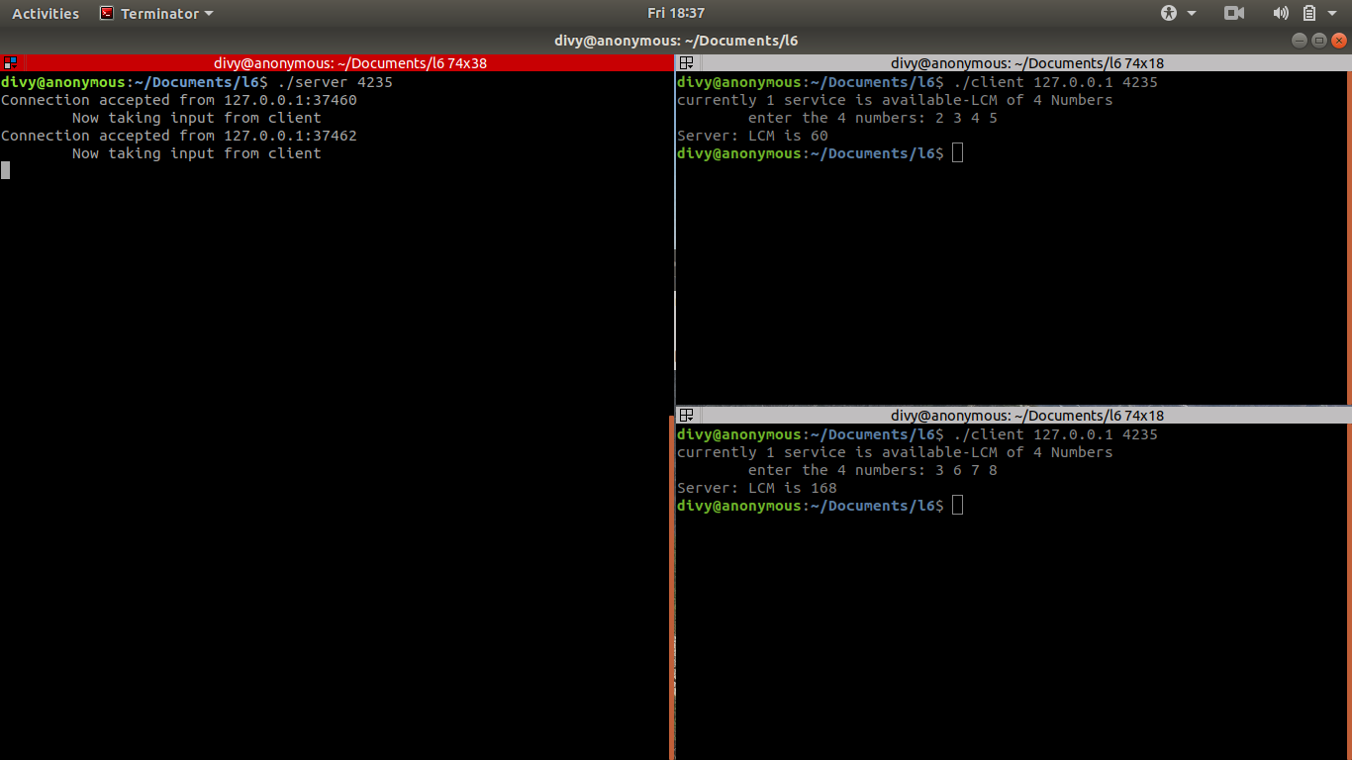

Slide 16
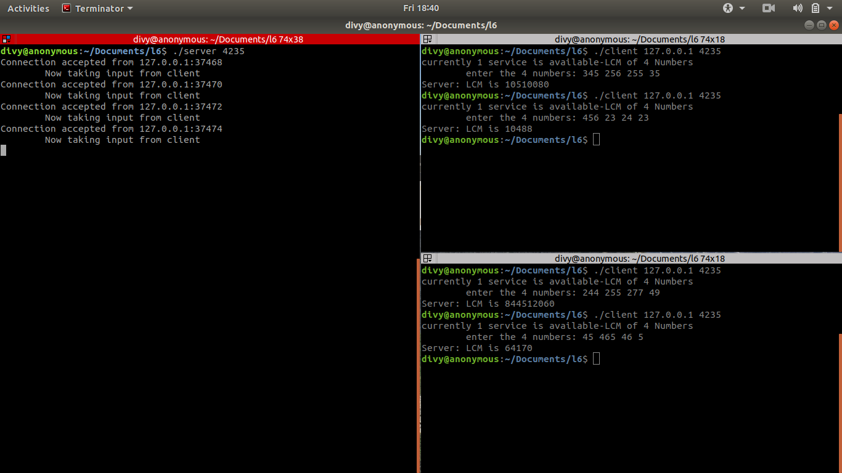

Slide 17
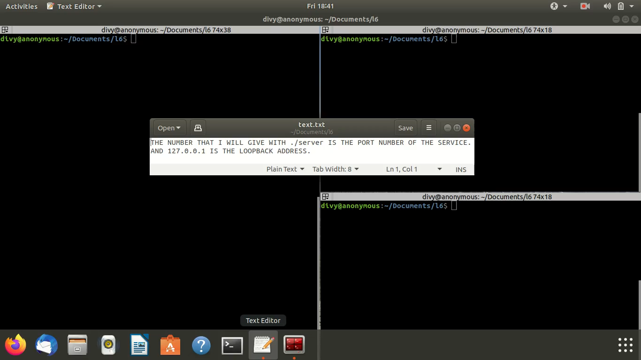

Slide 18
THANK YOU

